Slide 1


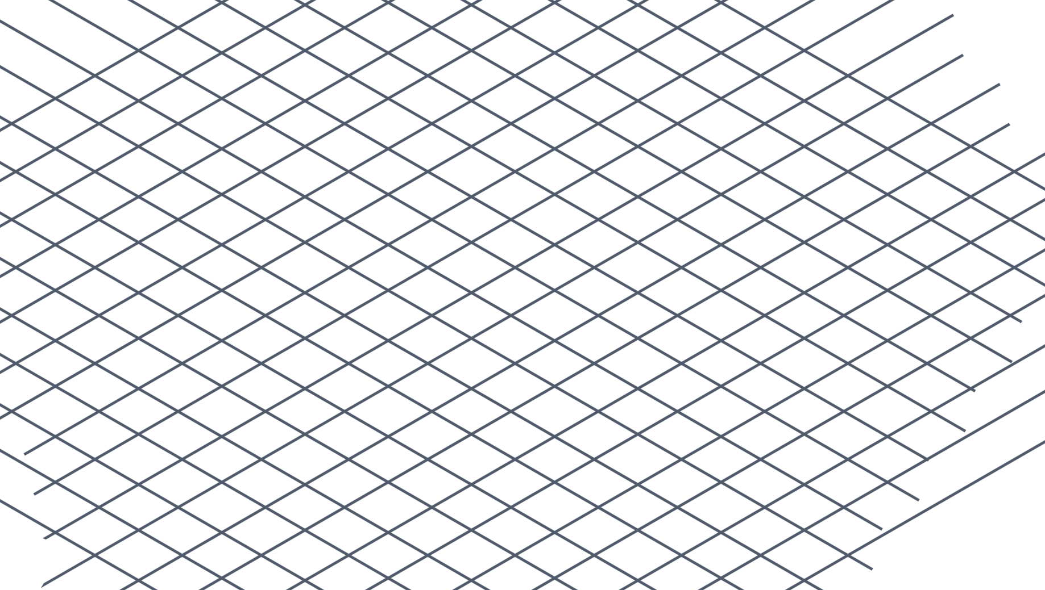
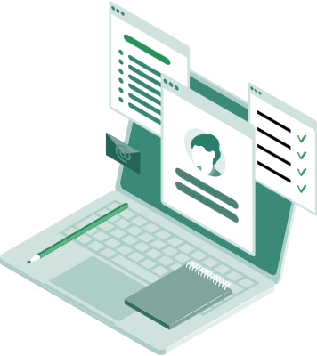

Learning and document reading solution
DolphinGroup
Pitch Deck 1.0
Knowledge at fingertips
dolphin.team111@gmail.com

Slide 2

Agenda
Survey report
Our “startup”
Problems
Proposed solution
Team member
Spirit, culture
Overview info
Vision & Mision
Current context &
difficulties
What are we going to do?

Slide 3




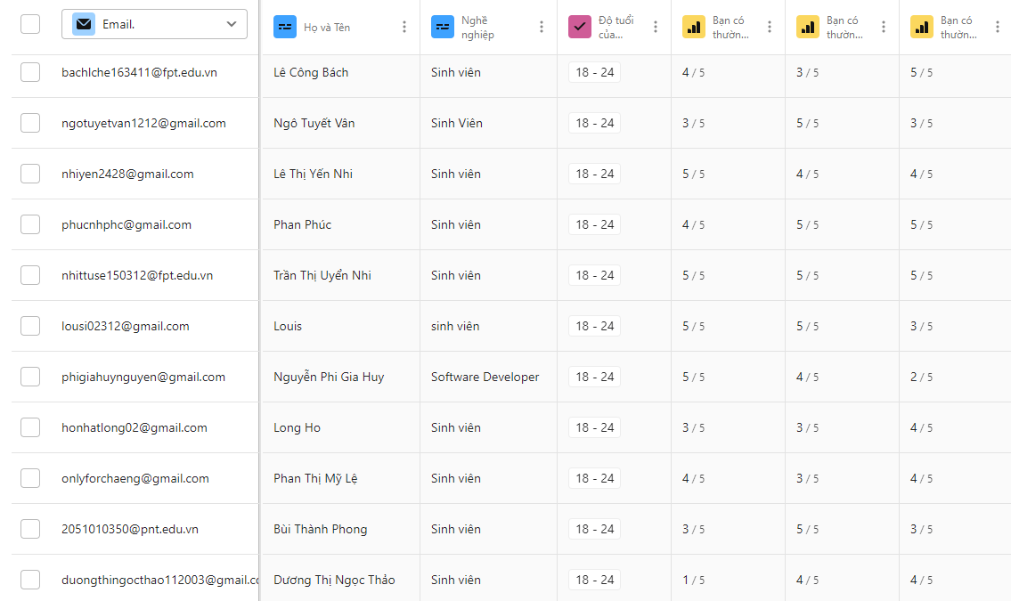
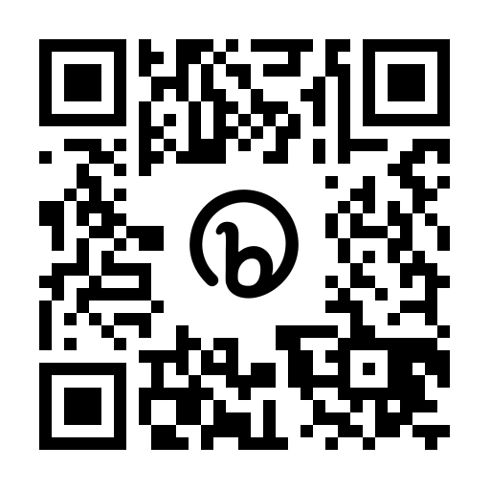
Survey report
Total views
Total Submissions
Valid Submissions
Completion rate
314
126
116
58.6%
bit.ly/tetu_report
Notes:
Simples is best, less is more

Slide 4
Align with the former stated context & problems
Traditional
5.2%
Digital
22.4%
Hybrid
72.4%
Note-taking demand
Feeling overwhelmed
Note-taking habits & overwhelming information problems
Note-taking methods
- Tetu survey report
Notes:
Simples is best, less is more

Slide 5
40.9% and 32.8% for interested and very interested
Self-assessment of process effectiveness
4.0
3.3
5
5
Interest of effective learning process
Average personal
effective score
4.2
Top 3 difficulties
5
Lots of movement and devices to deal with
46.6%
Managing and retrieving notes
44%
Lack of formatting and visualizing abilities in notes
42.2%
The need of a truly optimal solution
to support the learning process
- Tetu survey report
Notes:
Simples is best, less is more

Slide 6



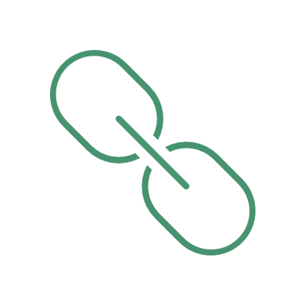


Preliminary conclusion
Extensively reading and jotting down
Leverage both physical and digital method
Great interest in personal productivity
“
Avid learners with balanced note-taking methods
and moderate-high interest.
Demand for a all-in-one yet simple solution
Impact factors when choosing app
User interface
”
Synchrony, connectivity
Cost
Personalization
Organization level
Notes:
Talk about productivity
An open book is a timeless symbol of learning and knowledge, representing the idea that knowledge is always available and ready to be explored.

Slide 7
Customer understanding
Notes:
Simples is best, less is more

Slide 8
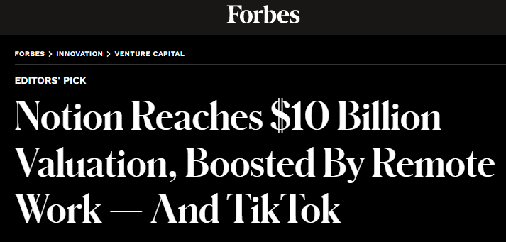
Market understanding
Market size
Learning aid
Document reader
Note-taking
Wiki
Knowledge base platform
Document collaborator
Personal information manager
General slogan
“A second brain for you, forever”
Notes:
Simples is best, less is more

Slide 9
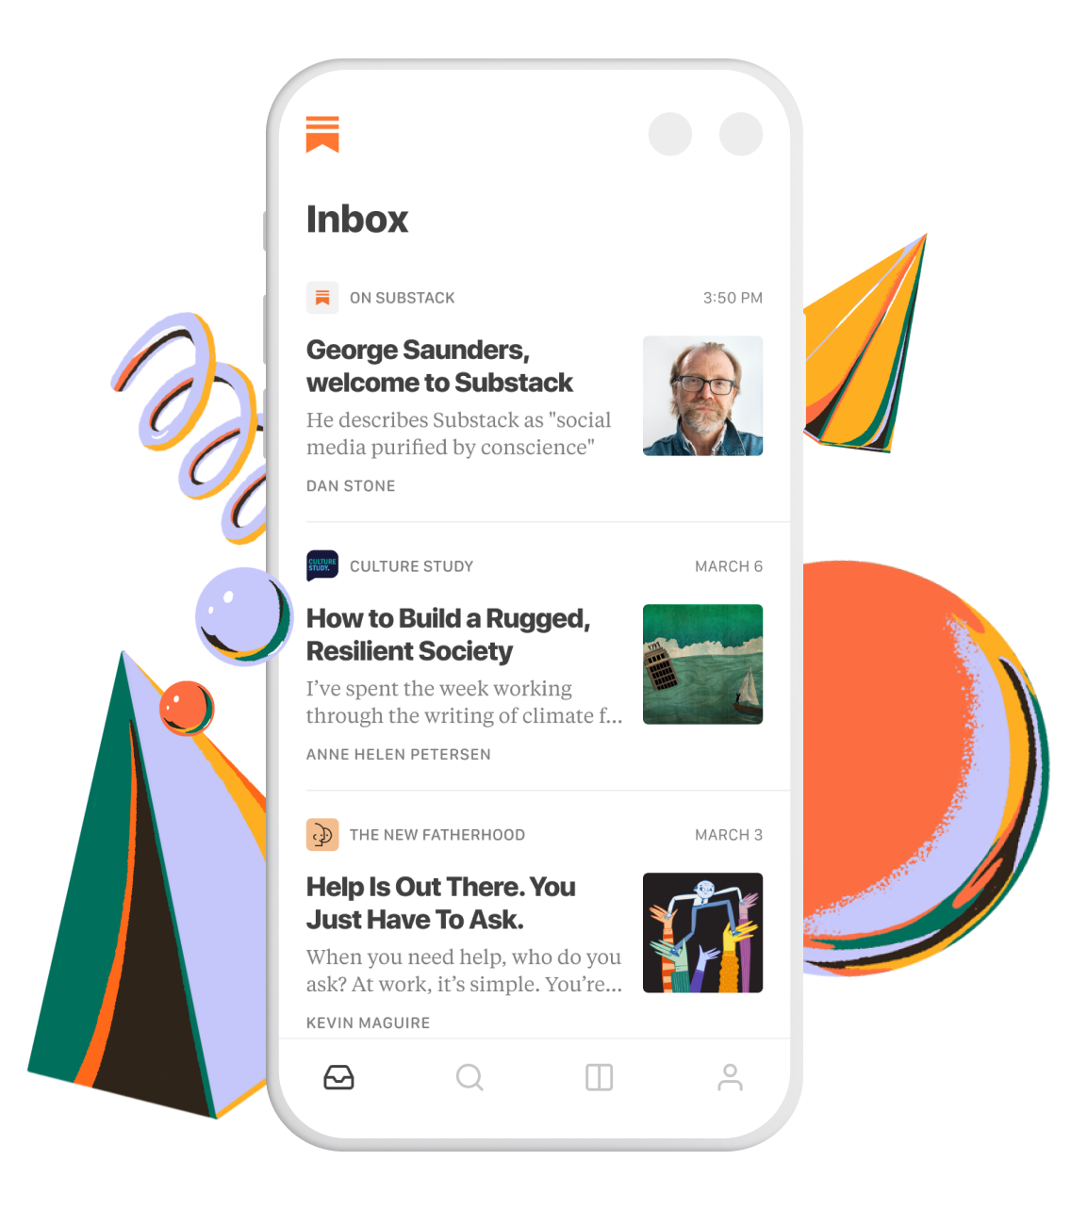



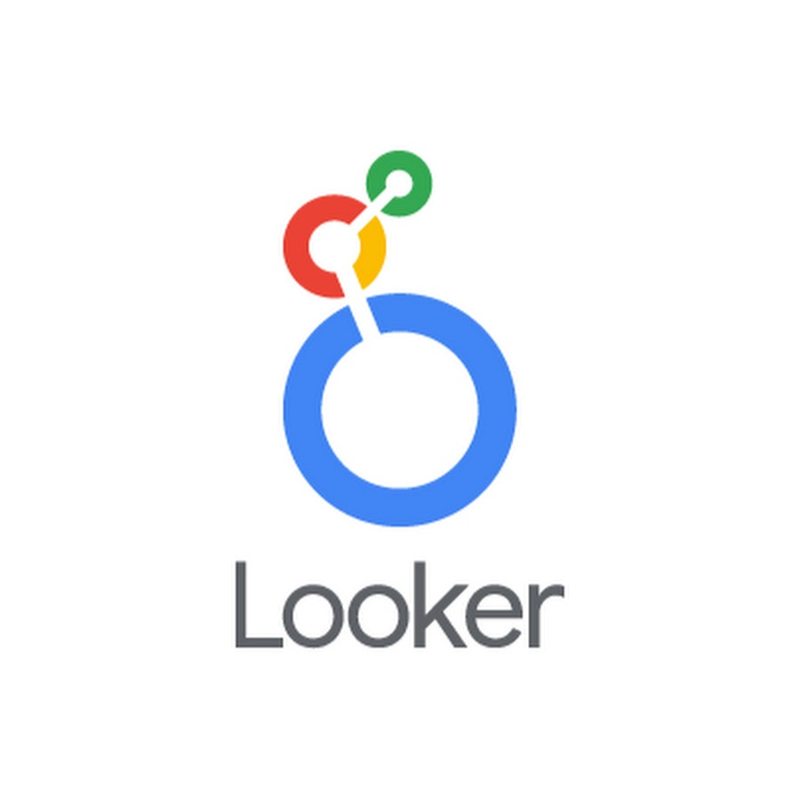

Market trend
Modularize into minor domain
Read
Meeting
Share images
acquired
Business Intelligence
Notes:
Simples is best, less is more

Slide 10

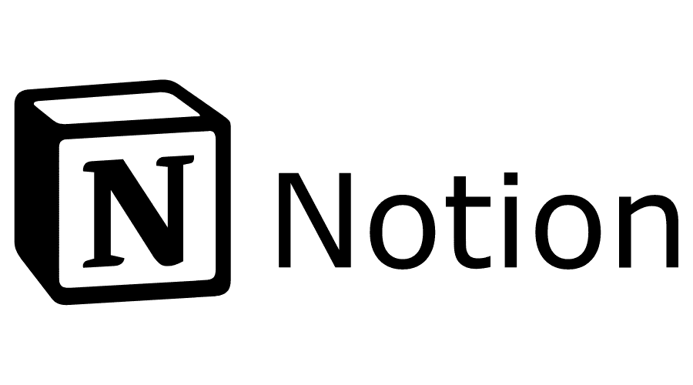
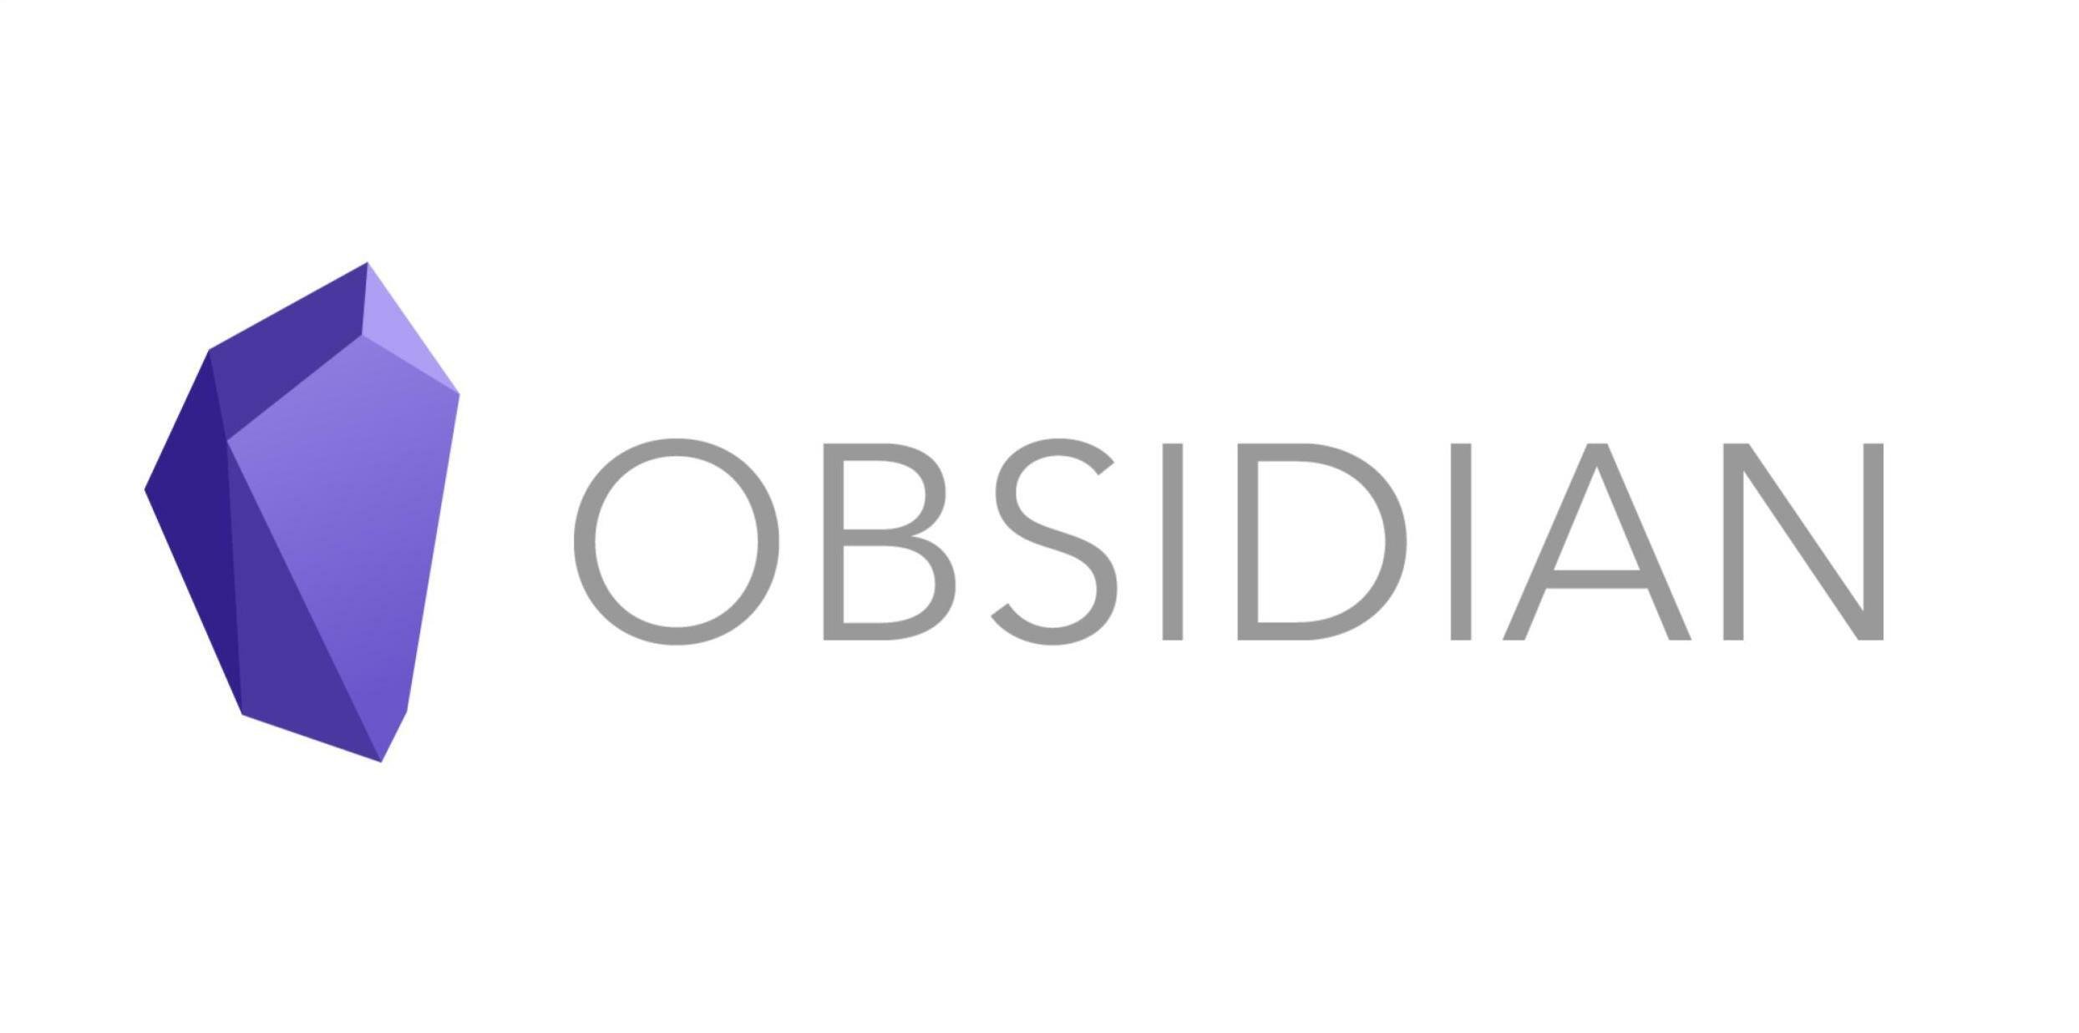
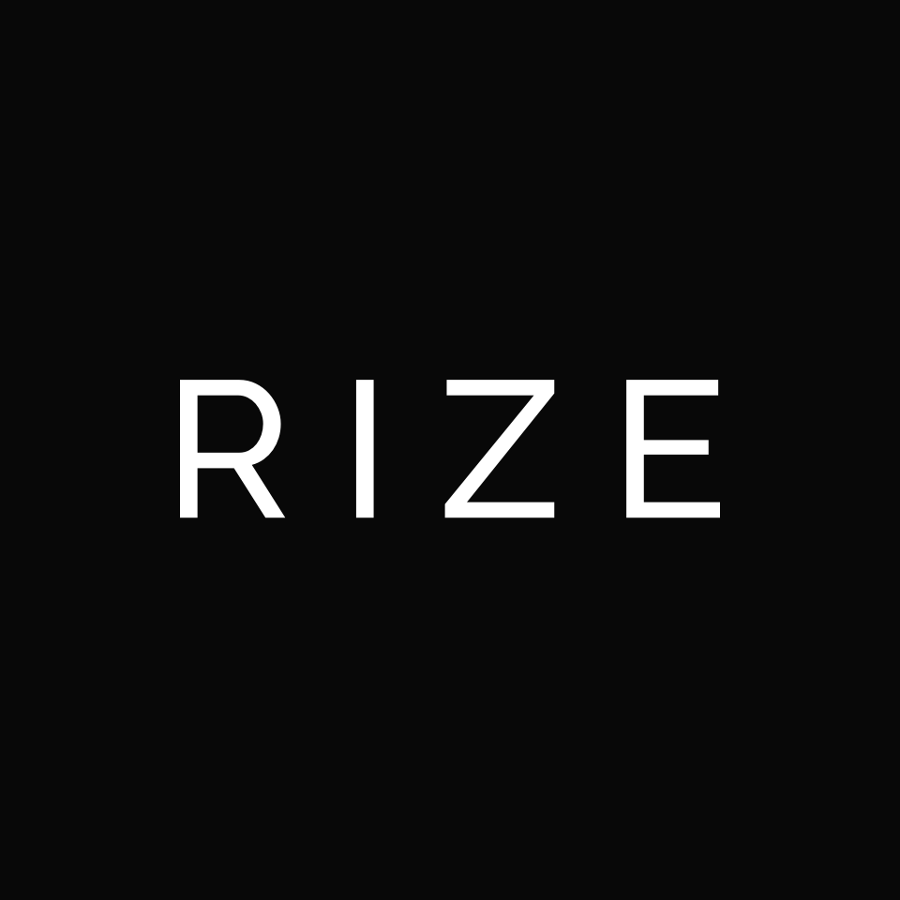
Market trend
Emerging productivity apps
time is most precious
The most views and engagement topics on Product Hunt
Notes:
Simples is best, less is more

Slide 11
Market trend
CRAVING CONVENIENCE
From always-available to pre-planned experiences
Notes:
Simples is best, less is more

Slide 12
Market trend
Phygital reality
Physical and digital world collid
seamlessly live, work
Top 10 global consumers trends in 2021 - Euromonitor International
Notes:
Simples is best, less is more

Slide 13
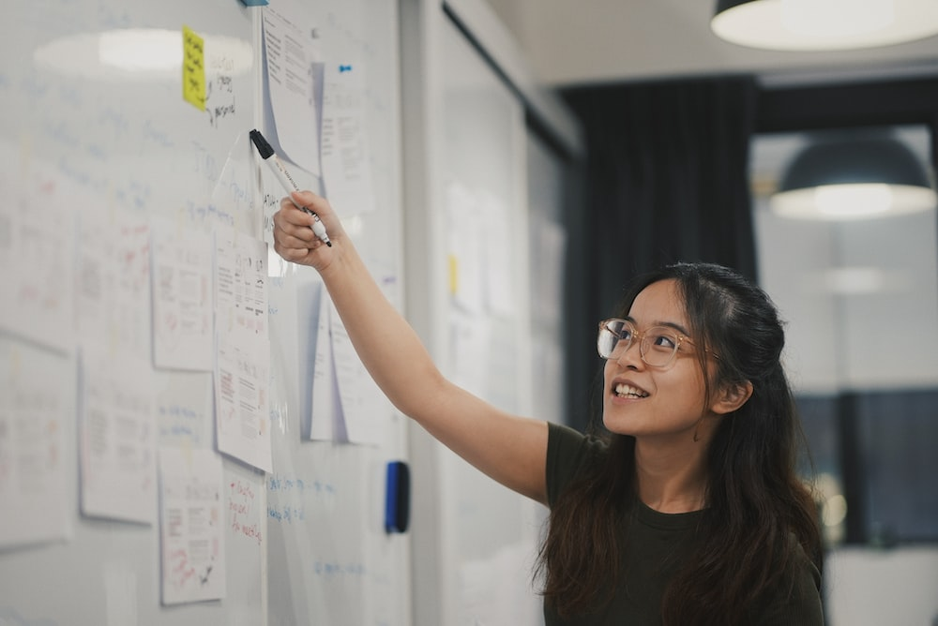
Customer segmentation
Traditional learner
Hobby Learner – 24%
Self-directed learners
High school/University student, 18 – 24 year-olds
Prefer a hybrid method: digital, books, in-person
Passionate for learning in a conventional environment
Career learner – 19%
Prefer reading and listening over group study
Multigenerational learners
Prefer learning through digital
Reluctant Learner – 17%
25%
Have little passion for learning
Skeptical learner -15%
Don’t think that school is for them
Traditional and Career learners are potential customers
- Pearson -

Slide 14
Customer segmentation
Behaviours
enjoy the engagement/social aspect of education
Vocation

Slide 15
Problems
“
Many documents are in the form of digital asset
Read lots of separate resources to get deeper understanding or find ideas
Diffuse ways of learning language through articles/news
Demand to take note and easily review
”
Inefficient note-taking and organization
Read file in one app and take note in another app, notes are stored distributedly
Lack of a personalized learning experience
Resources is unsynchronous make learning process cannot meet user needs
Time-consuming and boring learning process
Spend lots of time to figure out how to manage learning material
Inability to track progress and measure results
Traditional way of lesson reviewing make it hard to evaluate learning journey

Slide 16

Solutions
Build a cross-platform app that is able to:
Read a document file format like PDF/HTML/markdown/epub
Directly take note in app with powerful text editor
Organize note in a structured and synchronous manner
Intergrate with other resource management tool like Notion
Quickly learn a word/collocation/idiom in the passages
Put notes/words in a dictionary/notebook/card for further revision
Target audience
Satisfy the criteria
High school/university student
Office worker
Learner
Age: Gen X – Gen Y
Convenient
Personalized
Rapid
Lean
Notes:
Củng cố, hỗ trợ, hướng đến

Slide 17
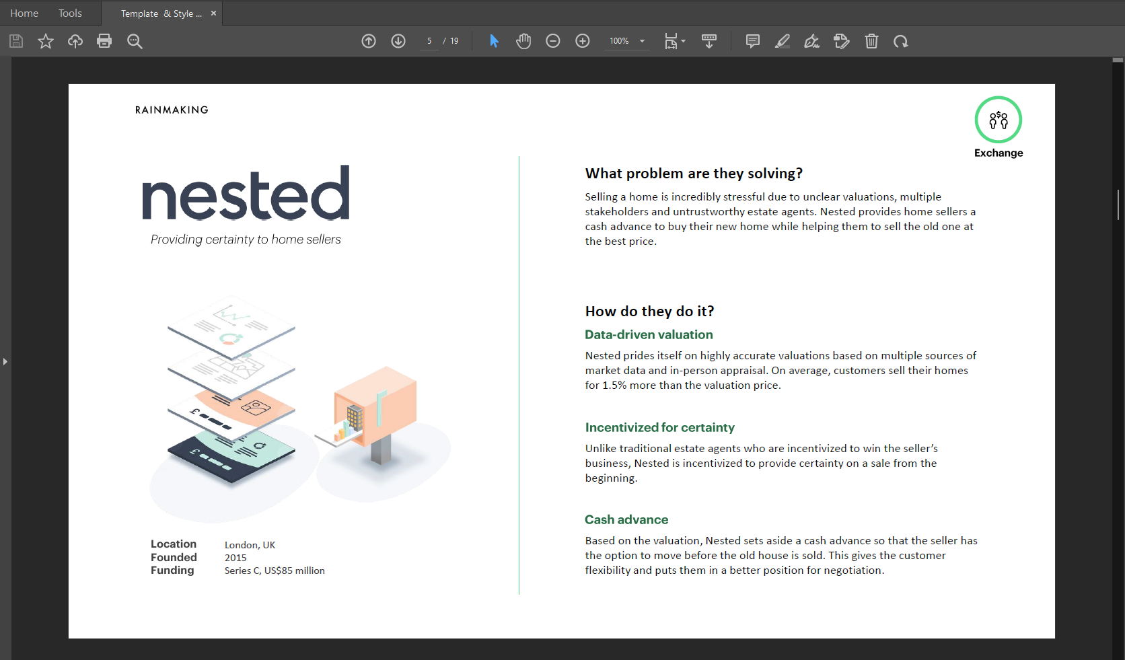
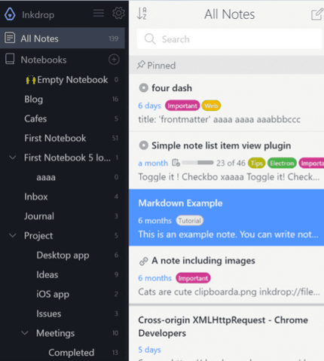
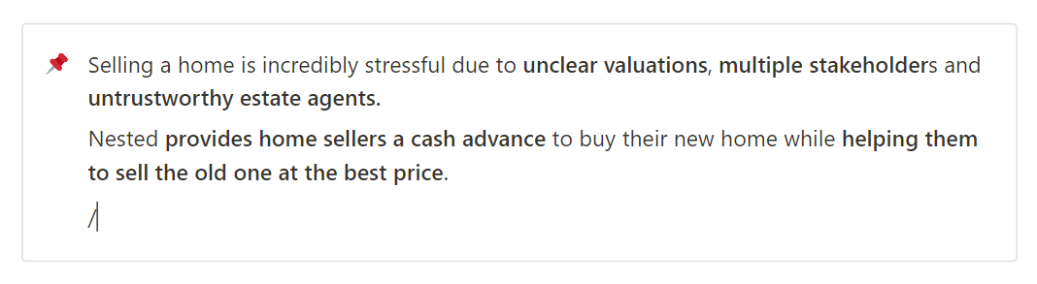
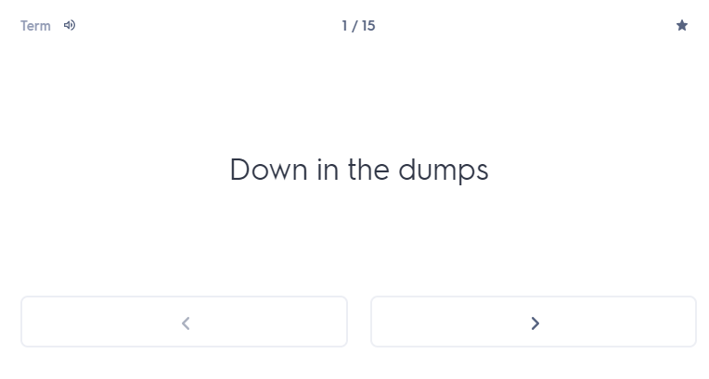
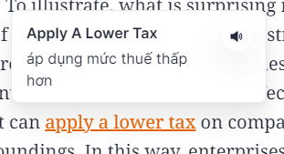
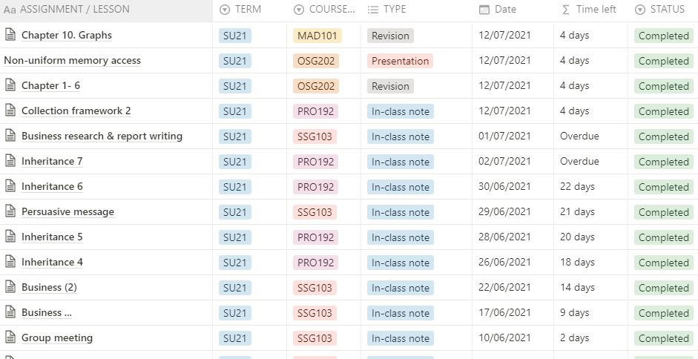
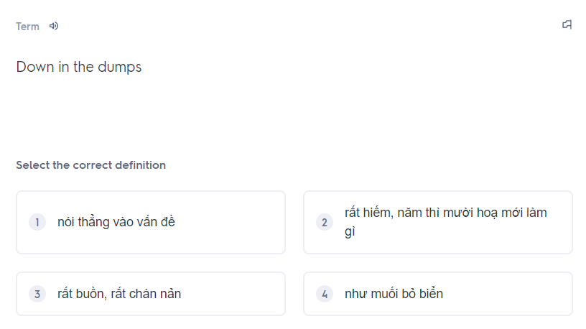
Moodboard
1. Read document files
2. Take note in app
3. Organize user’s notes
6. Store vocabs and revision
5. Learn a vocab
4. Intergrate with other tools

Slide 18

Executive summary
Problem
Read lots of separate resources
Inefficient note-taking and resources organization
Lack of personalization
Difficulties when reviewing those notes
Target audience
High school/university student
Office worker
Learner
Age: Gen X – Gen Y
Hobbies: learning, reading, researching
Solution
A hybrid-app can:
+ Read document file and take note in app
+ Organize notes in a structured and coherent manner
+ Create personal notebook to review, track progress and measure results
USP
Built-in note taking and intelligent organizing system
Integration with other tool
Less time-consuming for management
Goal
Positively impact people's behavior and study habits
Improve individual’s productivity, make learning effortless
Become top effective working and learning solution-providers

Slide 19


THANK YOU!
If you have any questions?
Don’t hesitate to ask us
or contact us
dolphin.team111@gmail.com
DolphinGroup

